Slide 1

强化学习基础-多智能体的概念和挑战
汇报人：李柏坤 时间：2022/1/16

Slide 2
目录
CATALOGUE
01
Settings设定
02
Terminologies术语
03
Convergence收敛
04
多智能体的中心化和去中心化
05
参数共享

Slide 3
COMPANY NAME
POWER POINT
Settings
设定

Slide 4
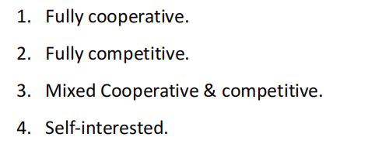
COMPANY NAME
POWER POINT
01
Settings
PART
利己主义

Slide 5
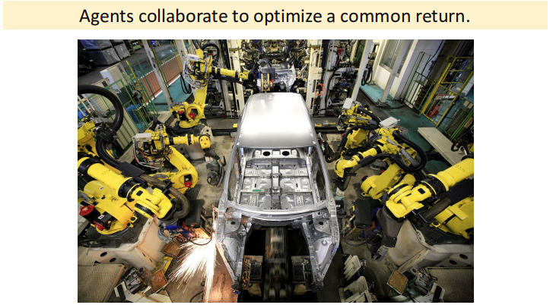
COMPANY NAME
POWER POINT
01
Fully Cooperative Setting
PART

Slide 6
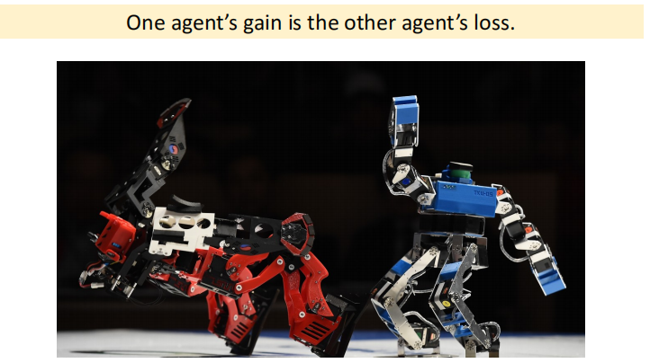
COMPANY NAME
POWER POINT
01
Fully Competitive Setting
PART

Slide 7
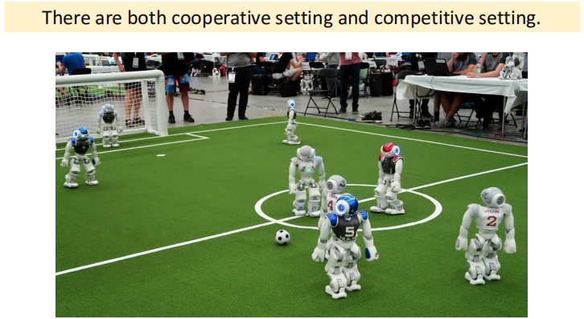
COMPANY NAME
POWER POINT
01
Mixed Cooperative & Competitive
PART

Slide 8
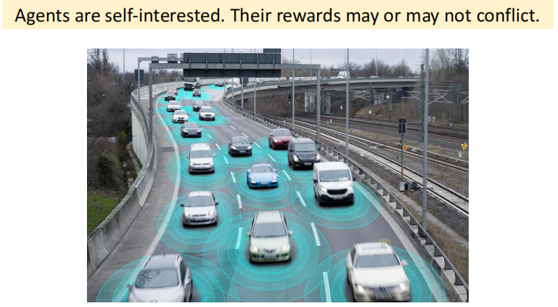
COMPANY NAME
POWER POINT
01
Self-Interested Setting
PART

Slide 9
COMPANY NAME
POWER POINT
Terminologies
术语

Slide 10
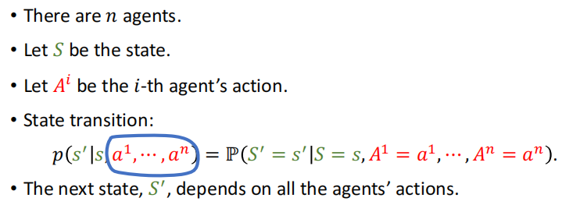
COMPANY NAME
POWER POINT
01
State, Action, State Transition
PART

Slide 11
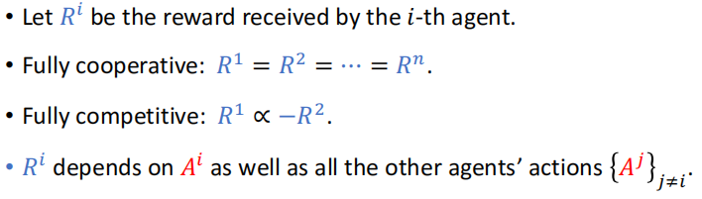
COMPANY NAME
POWER POINT
01
Rewards
PART

Slide 12
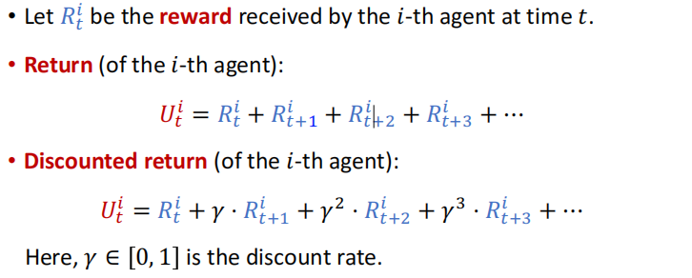
COMPANY NAME
POWER POINT
01
Returns
PART

Slide 13
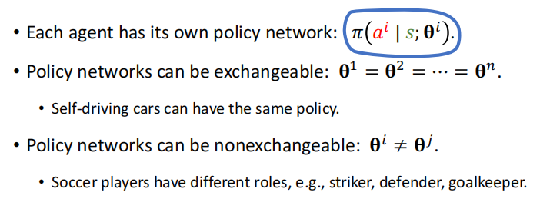
COMPANY NAME
POWER POINT
01
Policy Network
PART

Slide 14
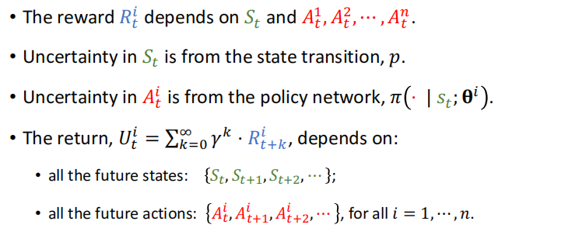
COMPANY NAME
POWER POINT
01
Uncertainty in the Return
PART

Slide 15
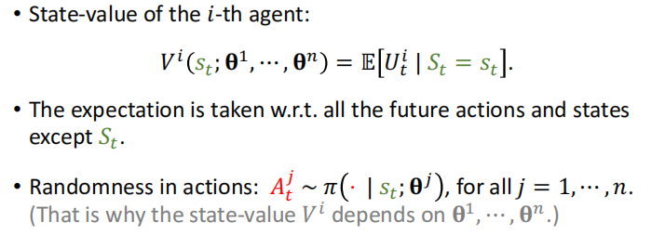
COMPANY NAME
POWER POINT
01
State-Value Function
PART

Slide 16
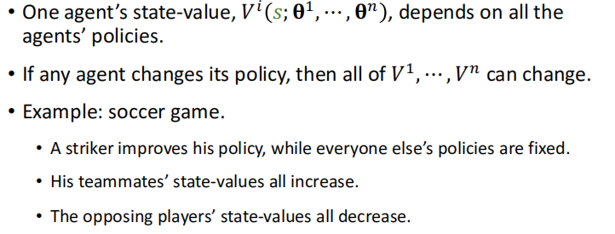
COMPANY NAME
POWER POINT
01
State-Value Function
PART

Slide 17
COMPANY NAME
POWER POINT
Convergence
收敛

Slide 18
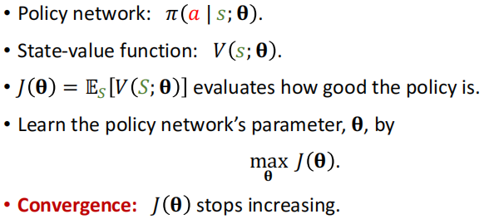
COMPANY NAME
POWER POINT
01
Single-Agent Policy Learning
PART

Slide 19
COMPANY NAME
POWER POINT
01
Multi-Agent Policy Learning
Nash Equilibrium 纳什均衡
PART
当其他 agent 的 policy 保持不变, 第 i 个 agent 不能通过更新自身的策略而获得更好的期望
每一个 agent 都对其他 agent 的策略做出最佳反应。
纳什均衡表明收敛，因为全部的 agent 都没有偏离现状的动机。

Slide 20
COMPANY NAME
POWER POINT
Multi-Agent Reinforcement Learning:
Centralized VS Decentralized

Slide 21
COMPANY NAME
POWER POINT
01
Architectures
Fully decentralized : 每个 agent 都使用自己的 observations 和 rewards 来学习自己的策略。agent 之间不通信。
Fully centralized : agent 把所有信息发送到 central controller. 控制器为所有 agent 做出决策。
Centralized training with decentralized execution : 训练期间使用 central controller。经过培训后，控制器被禁用.
PART

Slide 22
COMPANY NAME
POWER POINT
01
Partial Observations
An agent may or may not have full knowledge of the state,
Let be the i-th agent`s observation.
Partial observation:
Full observation:
PART

Slide 23
COMPANY NAME
POWER POINT
Fully Decentralized

Slide 24
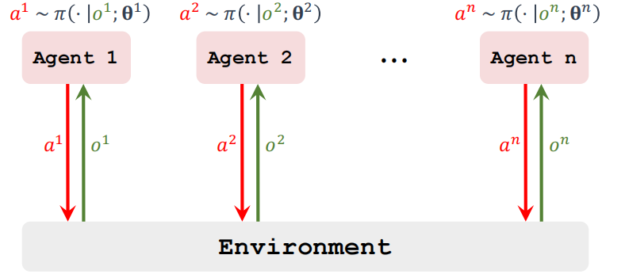
COMPANY NAME
POWER POINT
01
Fully Decentralized Training
PART

Slide 25
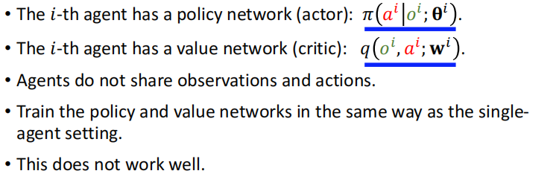
COMPANY NAME
POWER POINT
01
Fully Decentralized Actor-Critic Method
PART

Slide 26
COMPANY NAME
POWER POINT
Fully Centralized

Slide 27
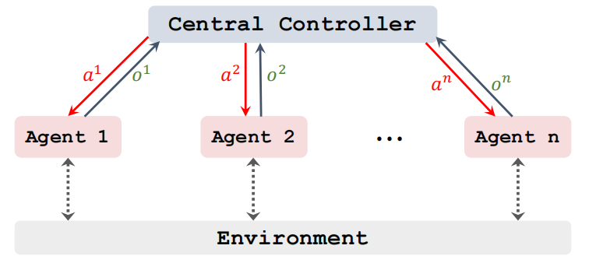
COMPANY NAME
POWER POINT
01
Centralized Training
PART

Slide 28
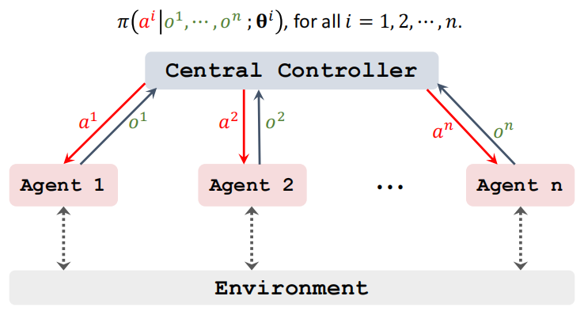
COMPANY NAME
POWER POINT
01
Centralized Execution
PART

Slide 29
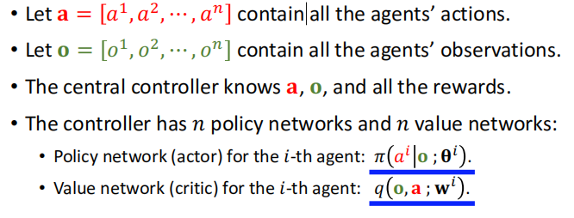
COMPANY NAME
POWER POINT
01
Centralized Actor-Critic Method
PART

Slide 30
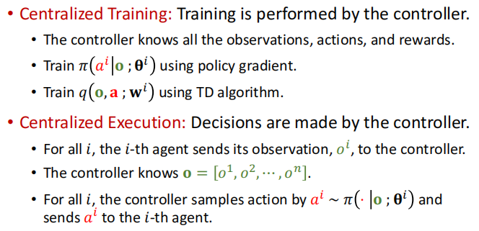
COMPANY NAME
POWER POINT
01
Centralized Actor-Critic Method
PART

Slide 31
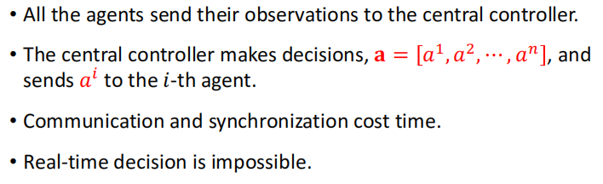
COMPANY NAME
POWER POINT
01
Shortcoming: Slow during Execution
PART

Slide 32
COMPANY NAME
POWER POINT
Centralized Training
with
Decentralized Execution

Slide 33
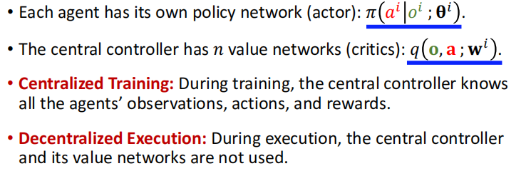
COMPANY NAME
POWER POINT
01
Centralized Training with Decentralized Execution
PART

Slide 34
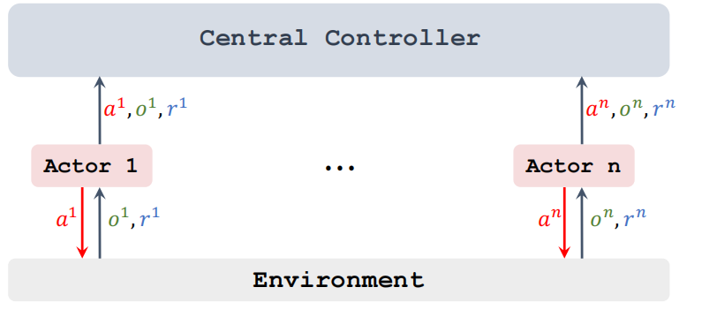
COMPANY NAME
POWER POINT
01
Centralized Training
PART

Slide 35
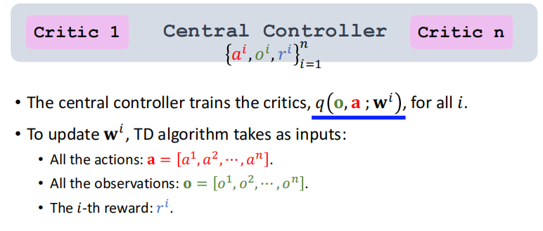
COMPANY NAME
POWER POINT
01
Centralized Training
PART

Slide 36
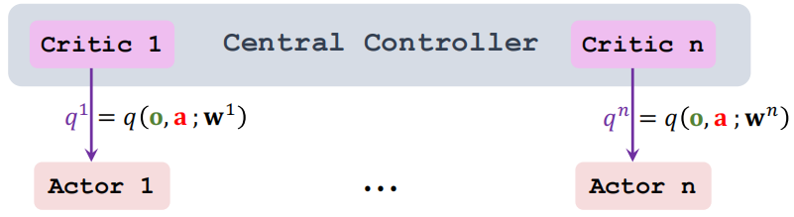
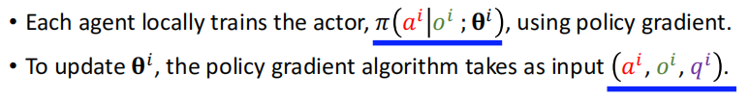
COMPANY NAME
POWER POINT
01
Centralized Training
PART

Slide 37
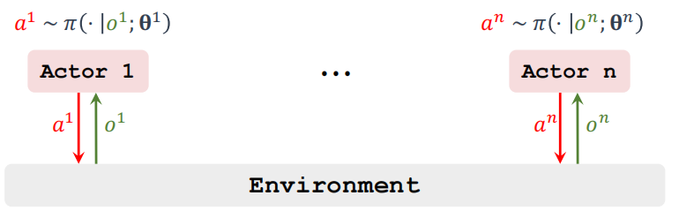
COMPANY NAME
POWER POINT
01
Decentralized Execution
PART

Slide 38
COMPANY NAME
POWER POINT
Parameter Sharing

Slide 39
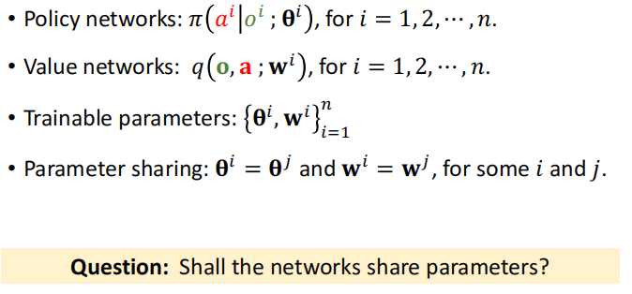
COMPANY NAME
POWER POINT
01
Parameter Sharing
PART

Slide 40
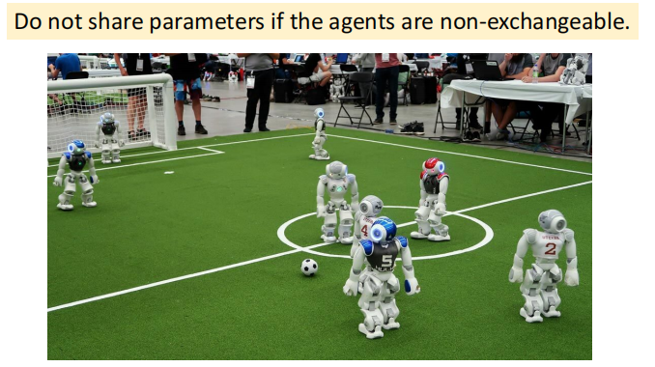
COMPANY NAME
POWER POINT
01
Parameter Sharing
PART

Slide 41
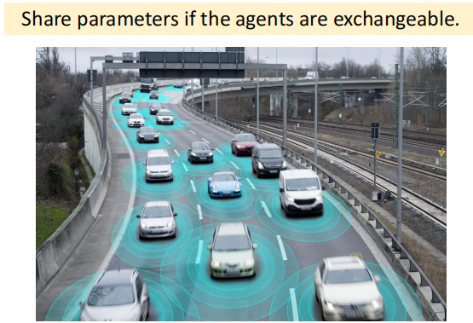
COMPANY NAME
POWER POINT
01
Parameter Sharing
PART

Slide 42
COMPANY NAME
POWER POINT
THANK YOU
汇报人：李柏坤 时间：2022/1/16

